Slide 1
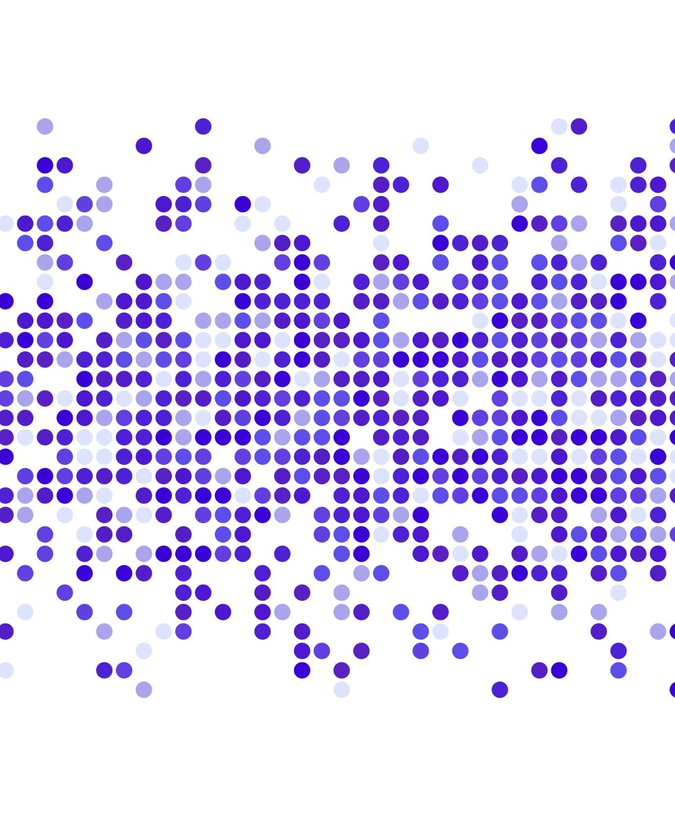
COMPUTER VISION IN ANOMALY DETECTION
Image and Video Processing
Team Members:
Aryan Rajoria
Mayesh Mohapatra
Pulkit Vyas

Slide 2
Problem Statement
In our Case study we are trying to create an algorithm that can detect anomaly in manufactured parts.
Specifically we are trying to create an algorithm which detects if die has properly cut a hole or not.
Our algorithm must do this in limited time.
Notes:
In our case study we are working on a system used for finding defects in parts manufactured on an Assembly Line. Specifically, the problem we are trying to tackle is that during manufacturing of car parts with Holes, there is sometimes defects were a hole is not cut properly. Current Computer vision techniques can be used to count the number of holes, but this fails when the parts have some dark regions, bent region that look like holes or when there are black spots on the part. Here, we have to build a system which is robust to these conditions and can do detection within a second (on iot device attached on machines). The system has to be able to do this in a single shot or with very few samples.
We need an algorithm which can find all parts that are defective with 100% recall. That means no anomalous part is passed.
We need the algorithm to run extremely quickly, even on low end hardware within 1 seconds.
thus we used Yolo, which is used around the globe
There are about 30-60 parts per minute on a line and some are even faster.

Slide 3
Related work
YOLO v5:
An object detector designed to create features from input images and then to feed these features through a prediction system to draw bounding boxes around objects and predict their classes.
The YOLO network consists of three main pieces.
Backbone - A convolutional neural network that aggregates and forms image features at different granularities.
Neck - A series of layers to mix and combine image features to pass them forward to prediction.
Head - Consumes features from the neck and takes box and class prediction steps.

Slide 4
Related work
DBSCAN:
A clustering algorithm which works on a density-based notion of clusters designed to discover clusters of arbitrary shape.
It is a significantly more effective in discovering clusters of arbitrary shape than other well known algorithms like CLARANS.
The DBSCAN algorithm uses two parameters:
minPts: The minimum number of points (a threshold) clustered together for a region to be considered dense.
eps (ε): A distance measure that will be used to locate the points in the neighborhood of any point.
Notes:
Density based spatial clustering of applications with noise, used for density based clustering, and can discover clusters of different shapes and sizes from a large amount of data containing noise and outliers.
minPts, the minimum number of points to be clustered together in a region to be considered dense ,

Slide 5
Dataset
The dataset consist of list of JSON requests containing:
1) The ViewId: which is the position of camera taking the image
2) The Sample Image path: which is the location of the sample image of a part
3) The Golden Sample Images: which is the location of the dataset with perfect sample of a part
4) The partId: this contains the partId of a given part
Total number of features: 8
All Image taken through “Omron STC” Industrial Cameras
Total number of images 1200 samples

Slide 6
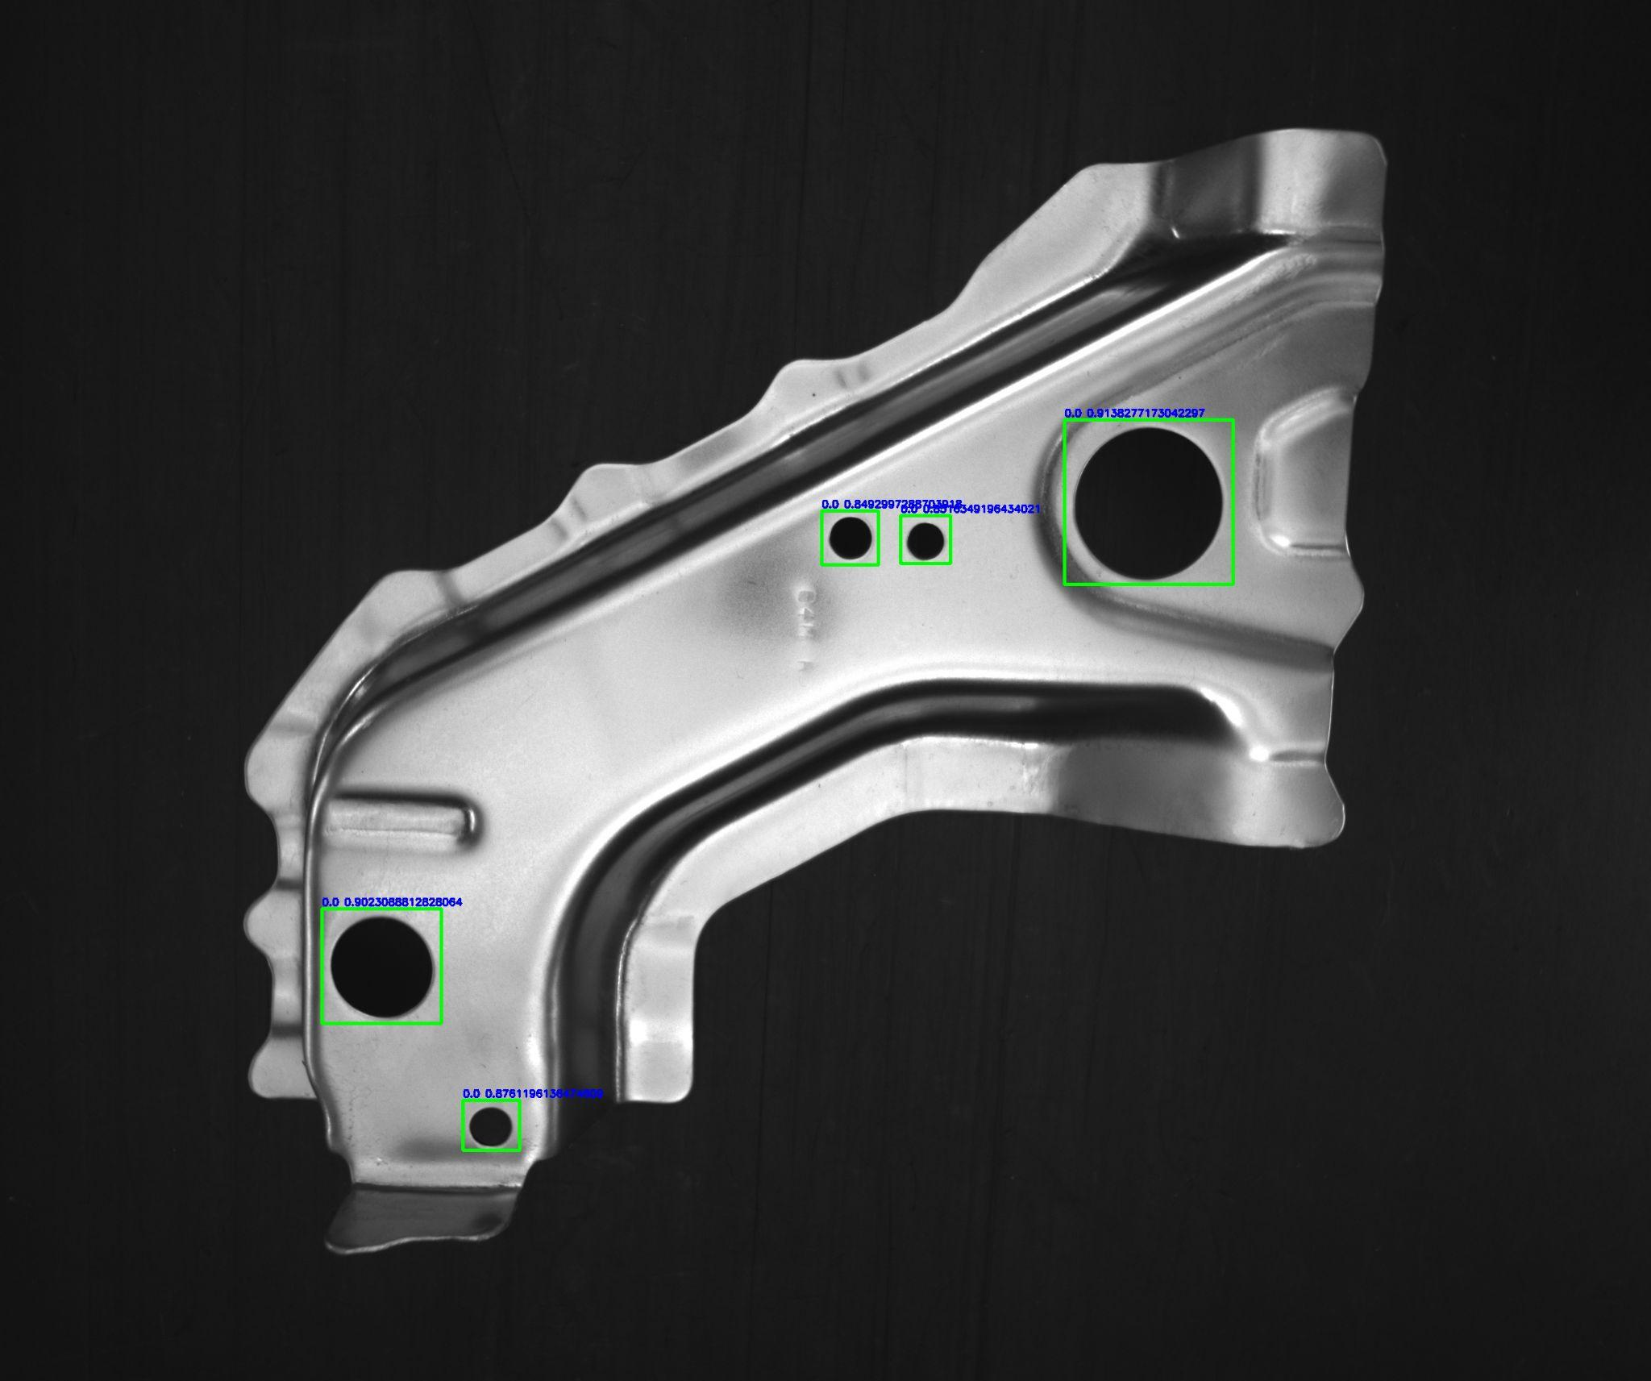
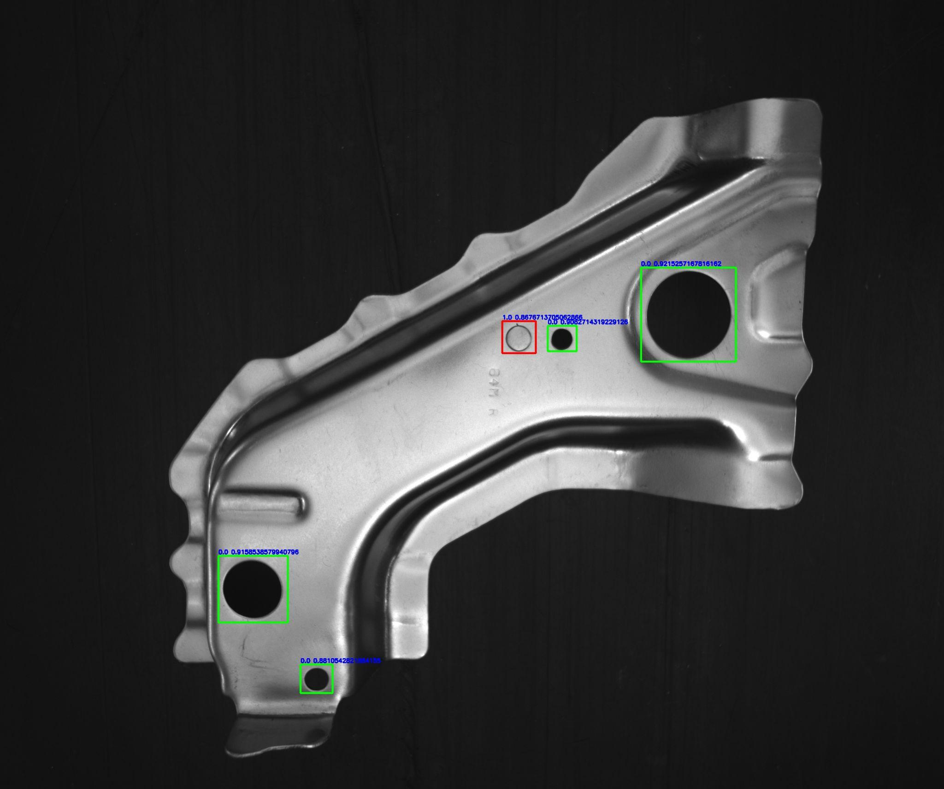
Dataset
Golden Sample
Sample Image

Slide 7
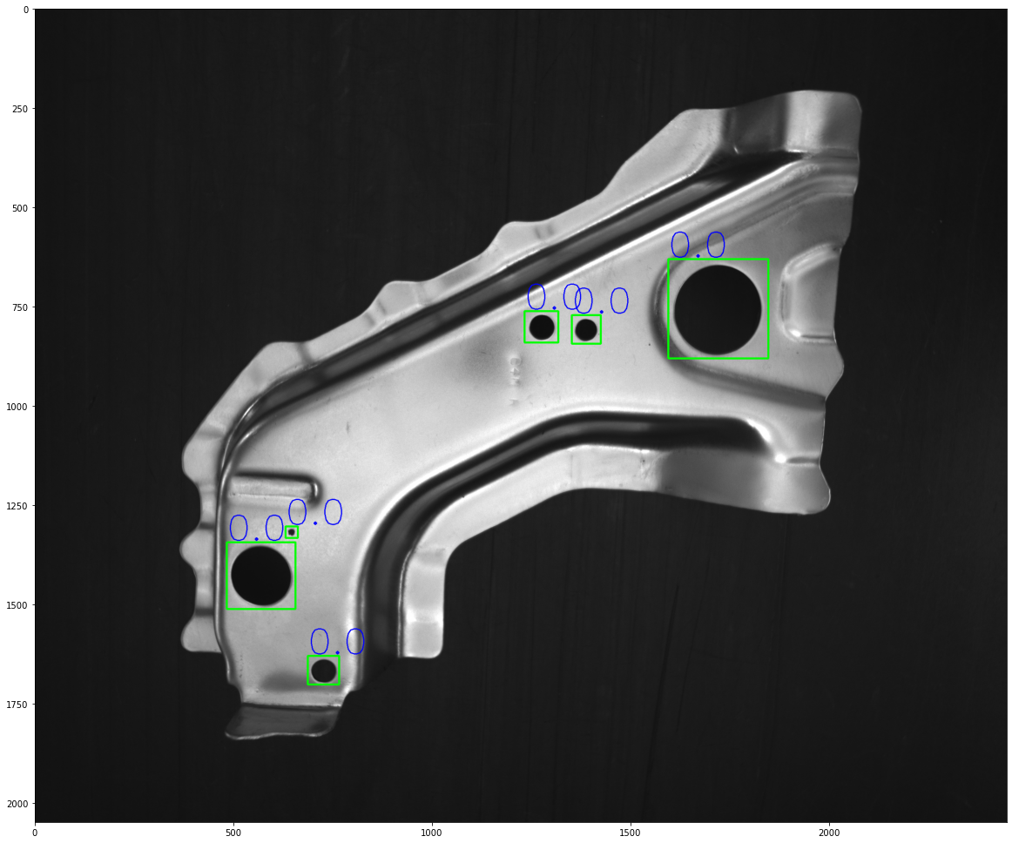
Dataset
Golden Sample
Sample Image

Slide 8
Architecture used
A two-stage architecture was trained and used for predictions
The first stage is a YOLOv5s model that is used for object detection of holes in the parts. The `s` model has been chosen due to its relatively fast inference with ~98ms using the pretrained model and mAP score of 56.0
The second stage is the DBScan part which takes in output from the first stage, calculates relative distance between holes, creates clusters and classifies outputs as noise or defect

Slide 9
Architecture used (custom)
YOLOv5 based detection
DBScan
Takes in the images and labels from the dataset and trains the object detection model to detect holes in the images
Takes in output from YOLOv5, plots the holes and creates clusters. The detections are ignored as noise if the cluster is far from the hole

Slide 10
Experimentation
Model and training details:
Model used: YOLOv5s, 7.2M parameters
Train-test split: 80%-20%
Epochs trained: 100
Hardware: Nvidia GeForce GTX-1080Ti

Slide 11
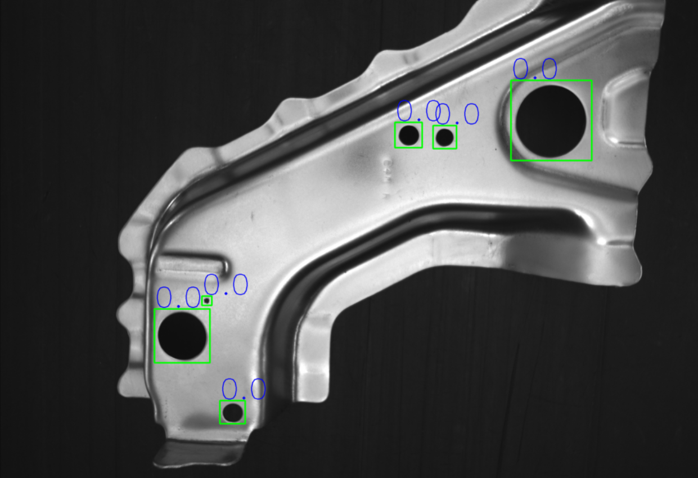
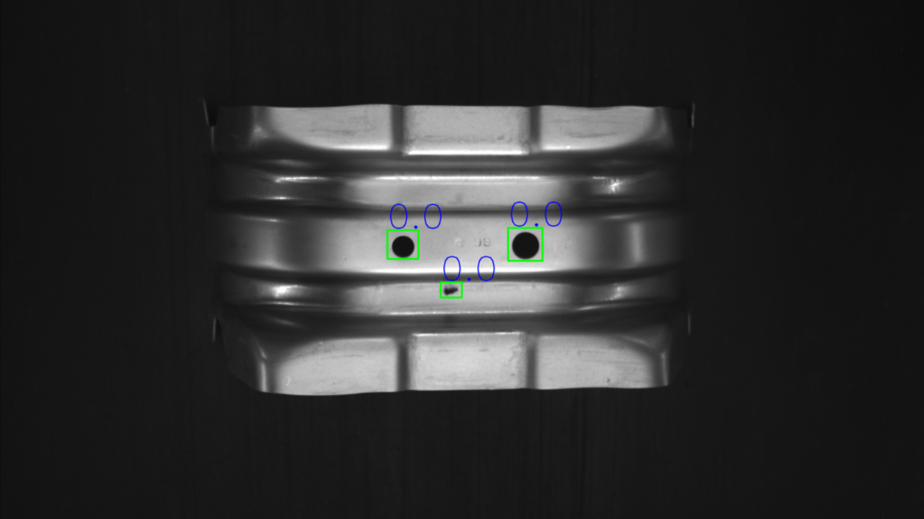
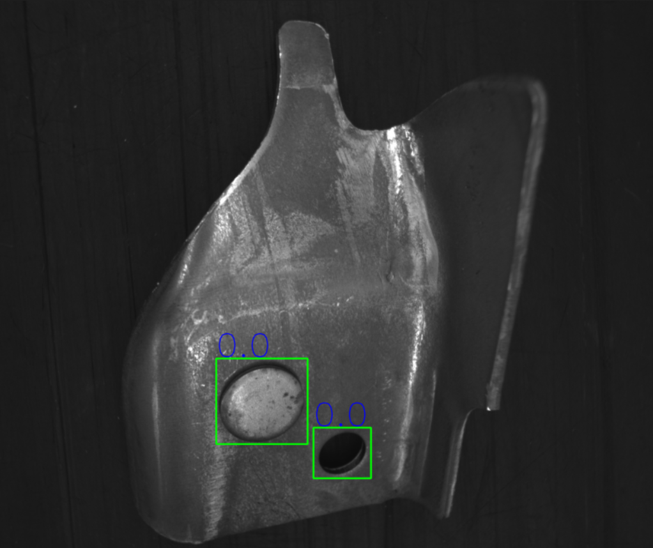
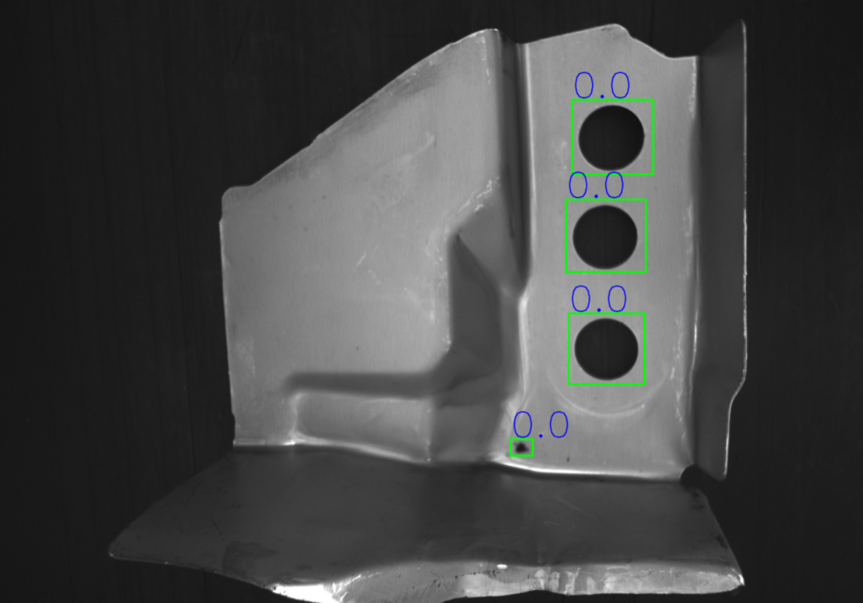
Qualitative results

Slide 12
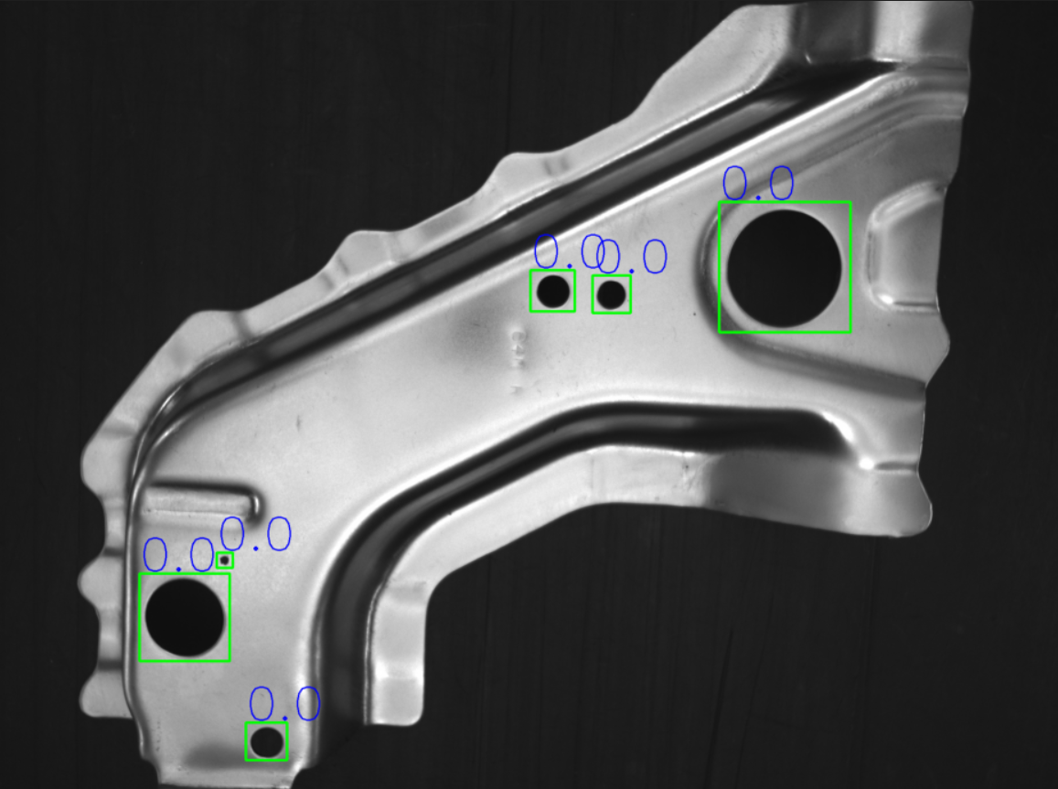
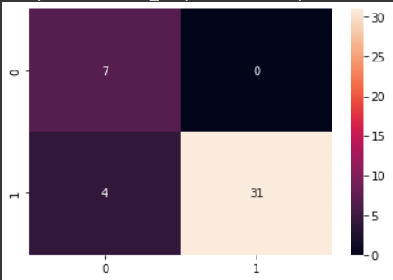
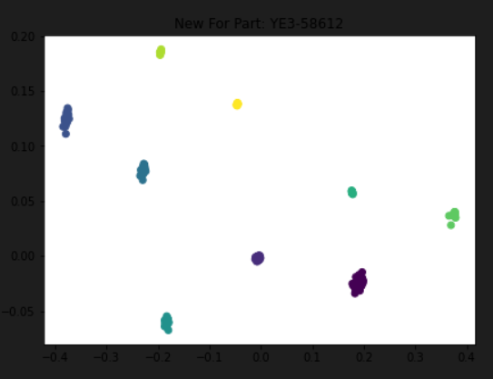
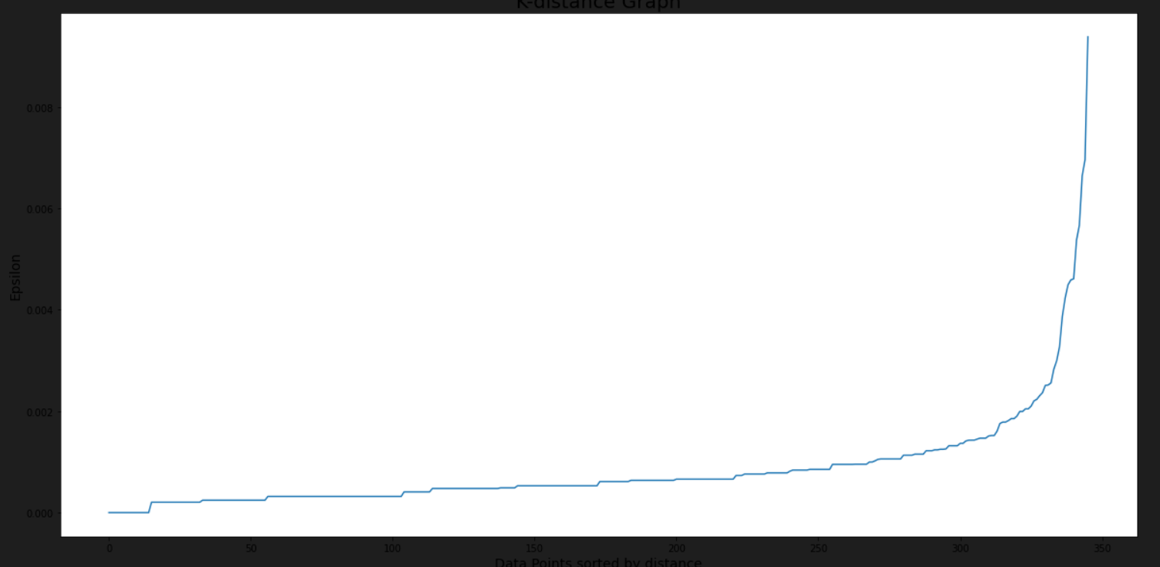

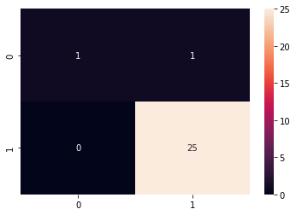
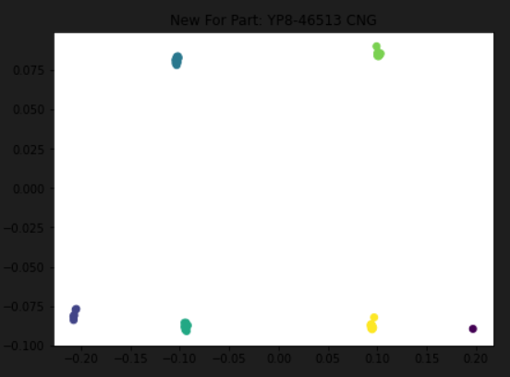
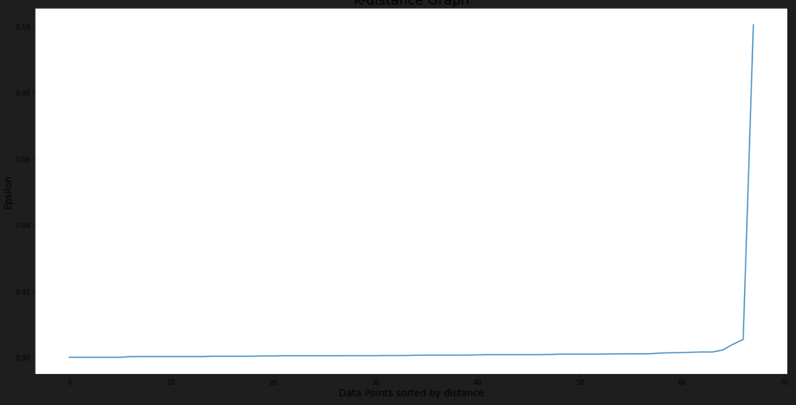
Quantitative results

Slide 13
Conclusion and future work
The proposed system shows high-recall and takes 0.56(+-0.2) seconds on average for inference
The one-day accuracy of the system in real-world testing was found to be 96%
Surface area of parts should be constant while creating dataset and making predictions
Combining relative positioning and DBScan might yield

Slide 14
Thank You

